Slide 1
Our London Tour
Buy a ticket for the Tube for one day.

Slide 2
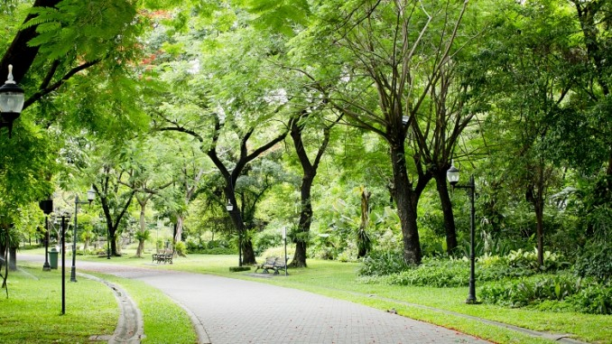
Green Park
Time 10:15
We start at Green Park, one of the biggest parks in London. It is historic.
We walk through it and in west end we can see Buckingham Palace.

Slide 3
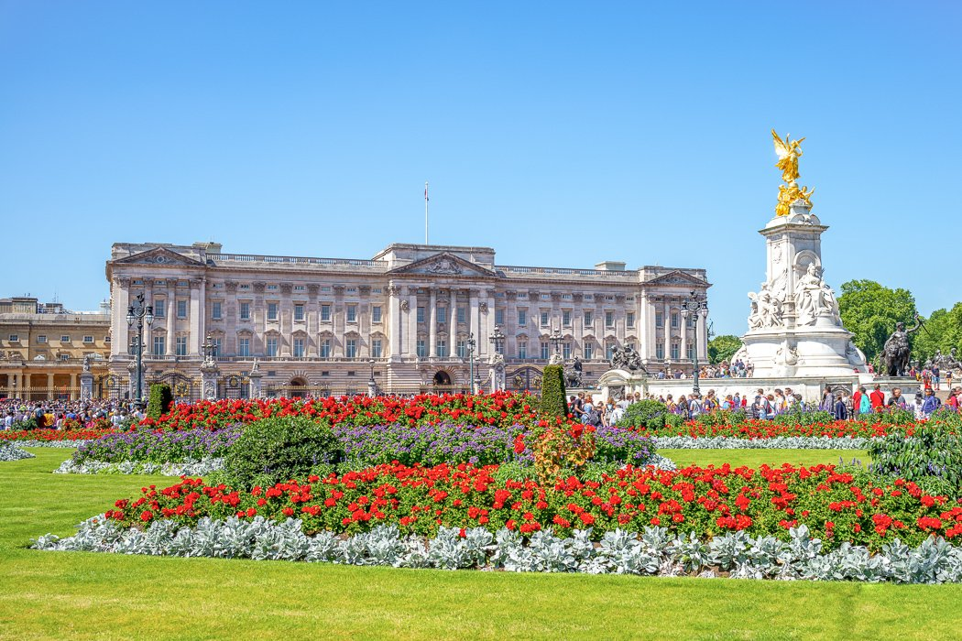
Buckingham Palace
Time 10:40
Buckingham Palace is the official residence of the British Royals. We can see at the royal flag when the Queen is in the palace. The big building has got 775 rooms and is also used for official state events. The ‚Changing of the guard‘ is every day in summer at 11.30 o‘clock, but a lot of people want to see it.
walk to Westminster Abbey

Slide 4
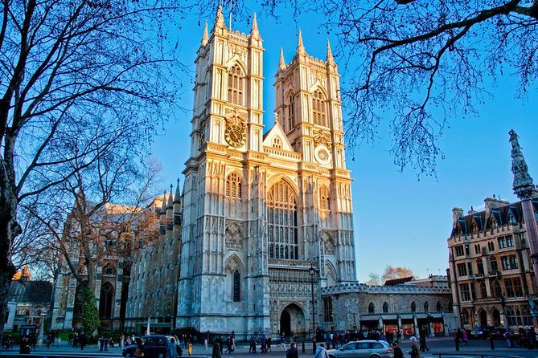
Westminster Abbey
Time 11:15
It is one of the best known churches in London with great architecture. Kings are crowned and buried there. We can look inside, but we can‘t take photos. The church is free.
short walk to the Houses of Parliament

Slide 5
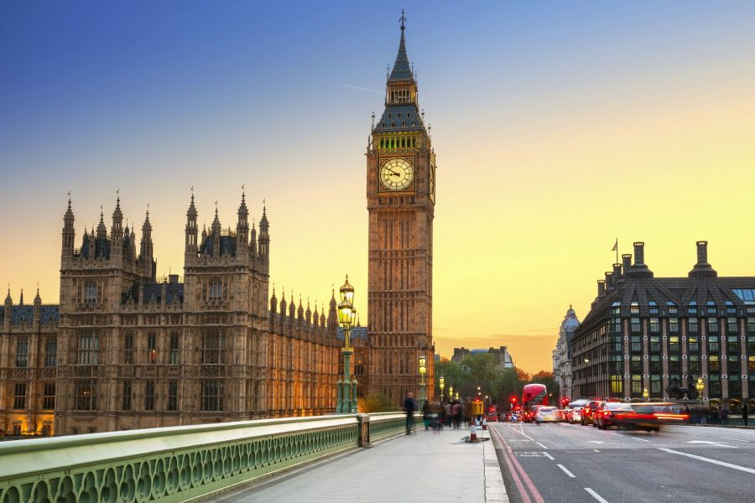
Houses of Parliament
Time 12:00
The Palace of Westminster is the seat of the British Parliament. It has over 1.100 rooms. The famous bell tower ‚Big Ben‘, is at the north side. Big Ben is about 96 metres high.
walk over the Westminster Bridge to the other side of the Thames

Slide 6
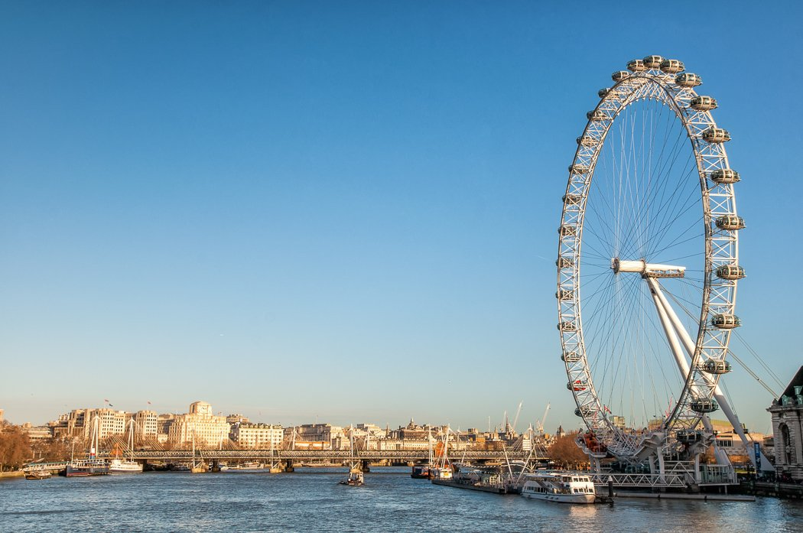
London Eye
Time 12:30
The ferris wheel is 135 metres high and the biggest of Europe. It has got 32 glass boxes. On top we have a beautiful view over London and we can take great photos. Our journey takes about 30 minutes.
When we buy our ticket online we don‘t have to wait too long.
go back to Westminster and take the Tube to Tower Hill

Slide 7
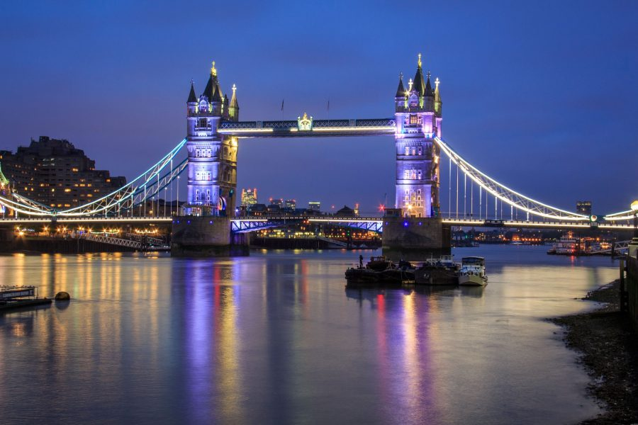
Tower Bridge
Time 13:45
We go to the Thames, sit down and have a break while we see the Tower Bridge. The Bridge is about 244 metres long and 65 metres high. It is one of the most famous sights of London. It can open when tall ships want to go through. We can walk over the bridge. It‘s free.
The Tower is next to the bridge.

Slide 8
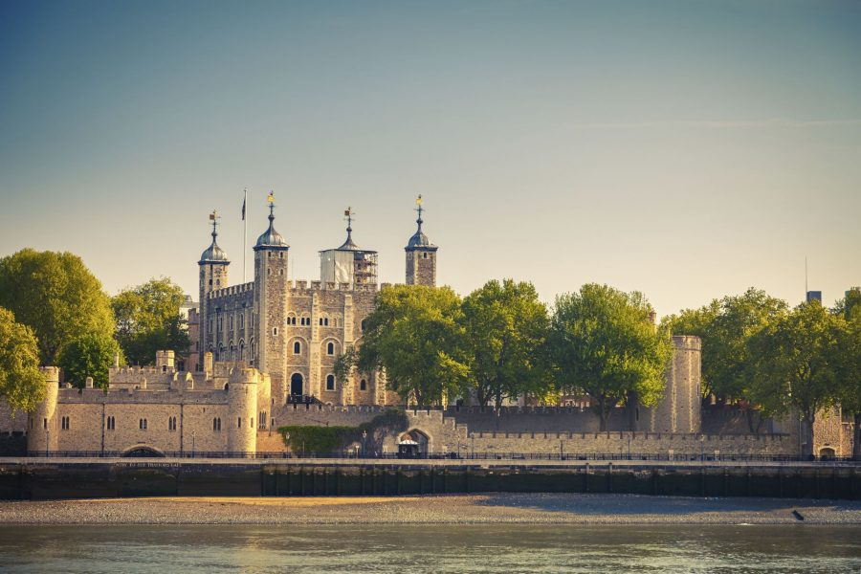
Tower of London
Time 14:45
In history the fortress was a residence and prison. Now we can see the crown jewels inside and learn a lot about history. It takes two till three hours to visit it and we have to pay for it. We don‘t go in. It is interesting to have a look at the London Wall next to the Tower.
go back to Tower Hill and take the Tube to St. Paul‘s

Slide 9
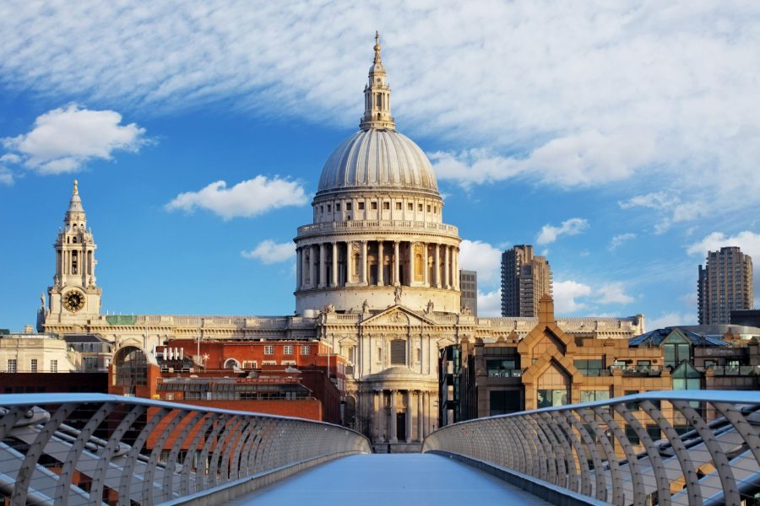
St. Paul‘s Cathedral
Time 15:45
St. Paul‘s Cathedral is one of the biggest cathedrals of the world. It has a great dome, but we have to pay to get in. We don‘t do that.
take the Tube to Covent Garden

Slide 10
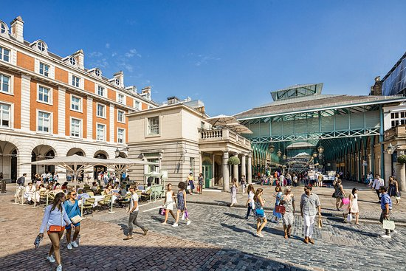
Covent Garden
Time 16:20
There are many small shops and cafes in the Covent Garden market. It‘s nice to have a small break and look at the street artists .
go along direction Leichester Square and Piccadilly Circus

Slide 11
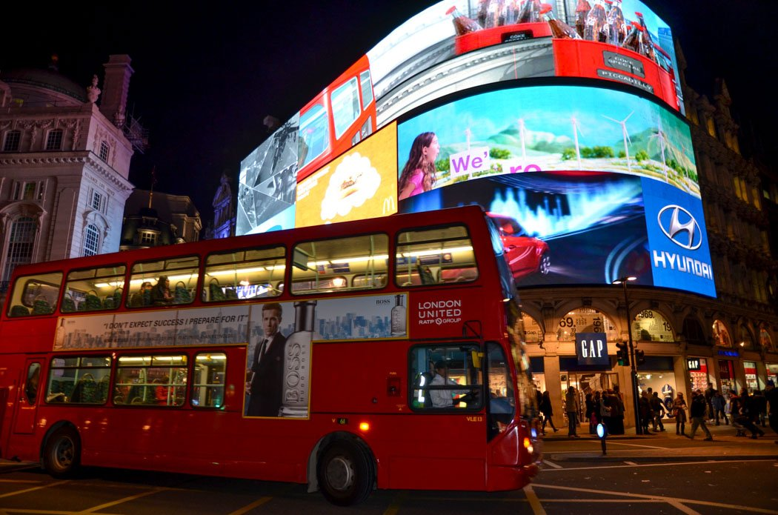
Piccadilly Circus
Time 17:15
It is a famous meeting point for a lot of people in the evening. There are many possibilities to go shopping, to visit a musical or a restaurant.
take the Tube back to Green Park

Slide 12
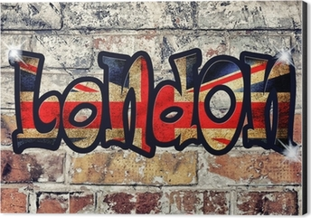
What a nice day ☺

